Slide 1
Statistical Learning & Data Mining:
Predicting Airfare on New Routes
Sumit Dighe KF006

Slide 2
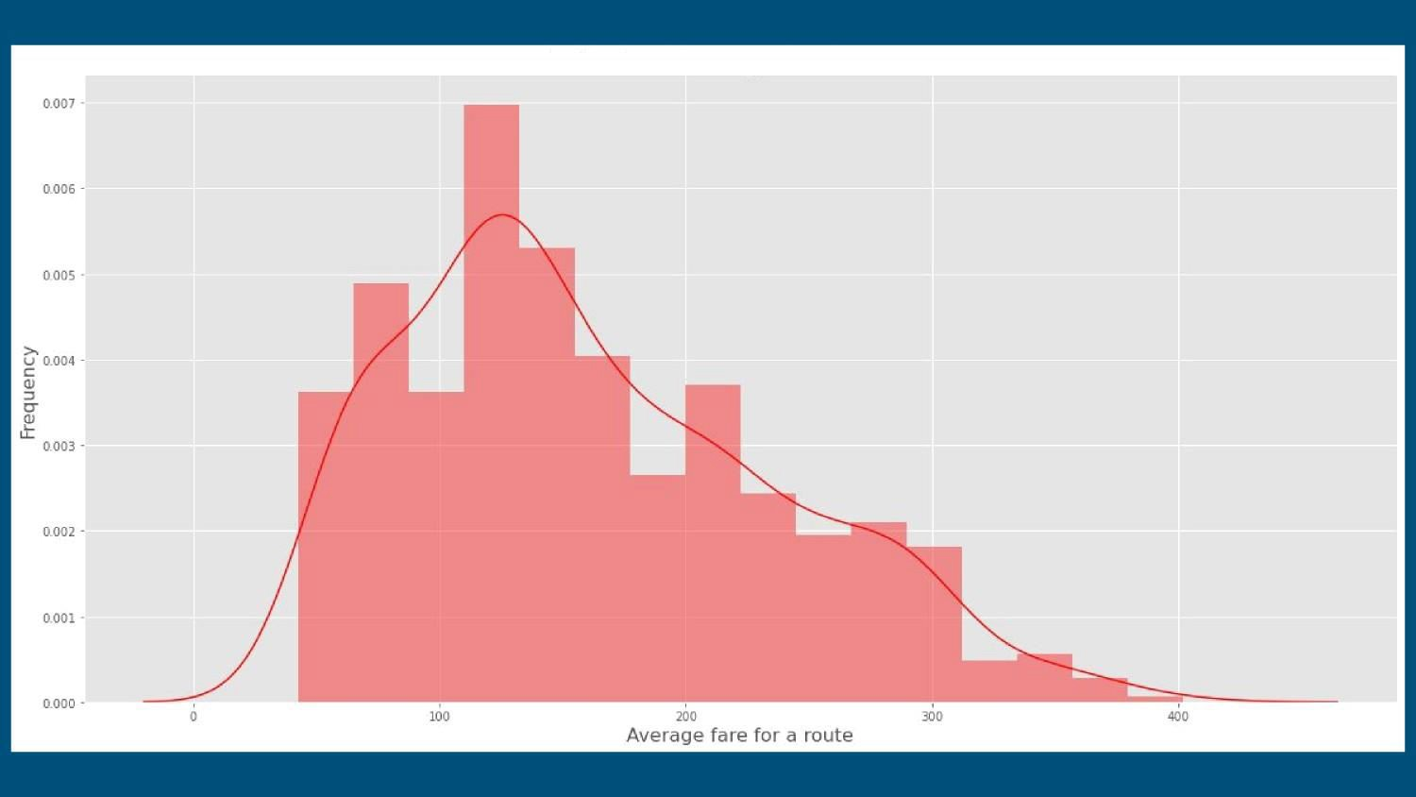
Distribution of average fare for a route

Slide 3
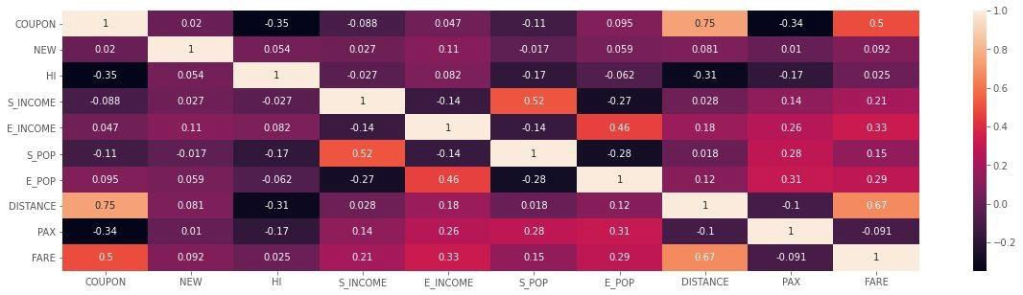
Correlation Heatmap

Slide 4
The above heat-map shows the correlation between every variable.
- It can be seen that FARE has highest positive correlation with DISTANCE and also has a moderate positive correlation with COUPON. It would mean that with increase in distance, the FARE is going to increase.
- DISTANCE has a strong positive correlation between COUPON. It means that, if distance between two points is more, then it is likely that there will be more coupons for that route.
- DISTANCE has the high negative correlation with HI. It can mean that, if distance between two points is less, then there would be lesser ﬂights operating and so the HI index would be more.
- COUPON has the highest positive correlation with DISTANCE. It would mean that if distance is more, then there is a possibility that there will be more coupons for that route.
- COUPON has high negative correlation with HI. It would mean that if a route has lesser ﬂights, then the HI
index would be more and coupons for that route will be less.

Slide 5
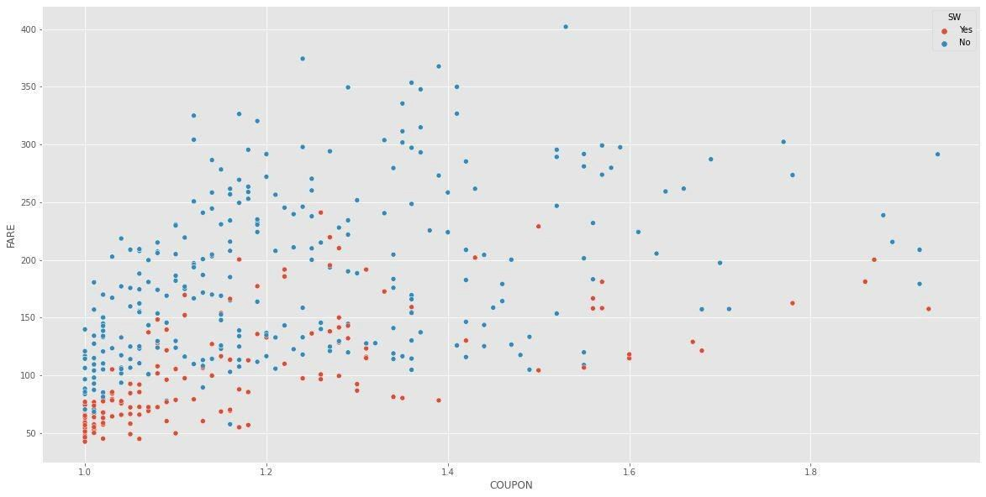
Scatterplot of Coupon vs Fare

Slide 6
The above scatter plot explains the relationship between Average COUPONS for a route and the FARE for that route. There is a positive linear relationship between both variables.
With increase in FARE for a route, there are more number of coupons for that route. It can also be seen that for routes where South-west airlines is operating (denoted by RED color), the FARE is low in majority of the cases.

Slide 7
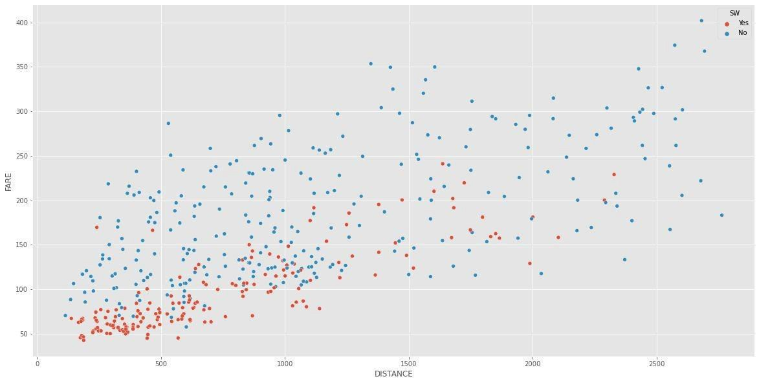
Scatterplot of Distance vs Fare

Slide 8
The above scatter plot explains the relationship between FARE and DISTANCE between two points. Wecan see that there is a strong positive correlation between DISTANCE and FARE. Also, we can infer that for majority of the cases, the FARE for a route operated by South-west Airlines is below $200.

Slide 9
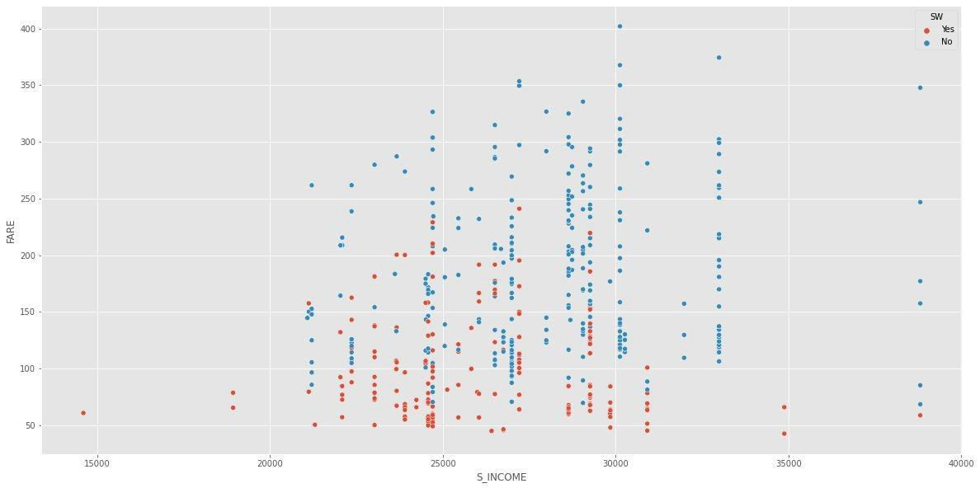
Scatterplot of S_Income vs Fare

Slide 10
The above scatter plot shows the relationship between FARE and Starting City's Average Income.
Wecan see that it has a linear positive relationship between FARE and S_INCOME. Also, based on the plot we can say that, majority of the South-west Airlines customer starting from a city are having an average personal income in between $20000 to $30000.
Also, we can infer that for majority of the cases, the FARE for a route operated by south-west Airlines is below $200.

Slide 11
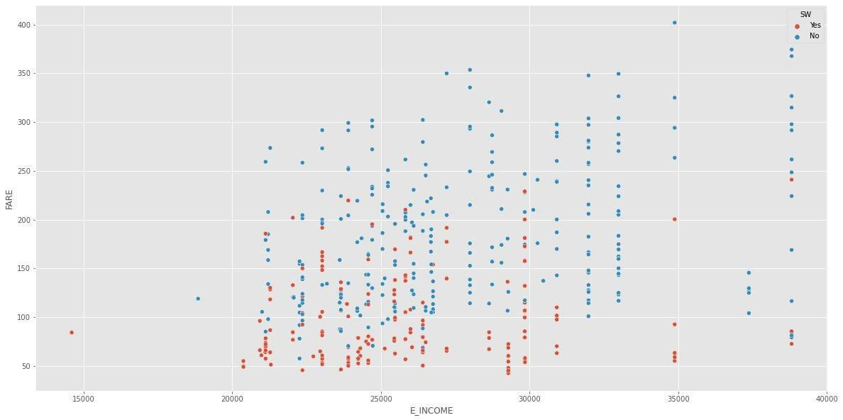
Scatterplot of E_Income vs Fare

Slide 12
The above scatter plot shows the relationship between FARE and Ending City's Average Income.
We can see that it has a linear positive relationship between FARE and E_INCOME.
Also, based on the plot we can say that, majority of the south-west Airlines customer ending at a city are having an averagepersonal income in between $22000 to $30000.

Slide 13
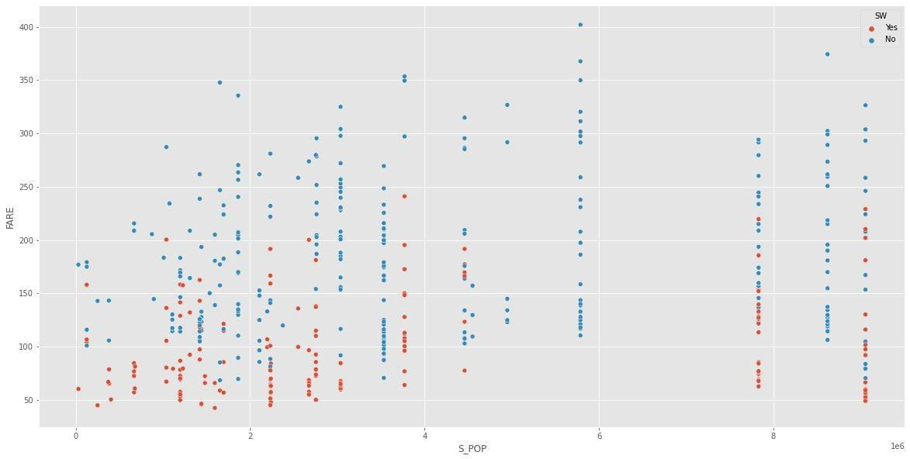
Scatterplot of S_Pop vs Fare

Slide 14
The above scatter plot explains the relationship between Average Fare and Starting City's population. There is a small positive correlation between both the variables.
It can also be veriﬁed from the heat map generated above which shows the correlation between both variables as 0.15

Slide 15
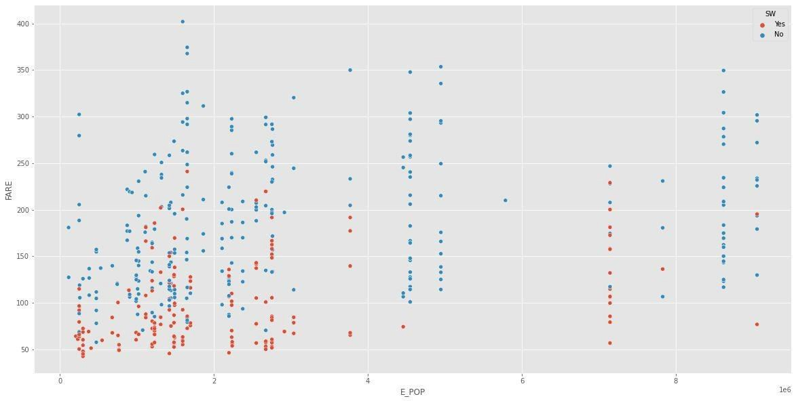
Scatterplot of E_Pop vs Fare

Slide 16
The above scatter plot explains the relationship between Average Fare and Ending City's population. There is a small positive correlation between both the variables.
It can also be veriﬁed from the heat map generated above which shows the correlation between both variables as 0.29.

Slide 17
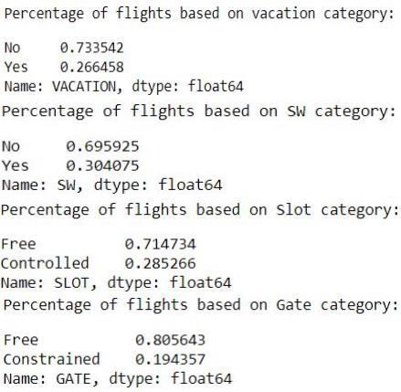

Slide 18
1 - Wecan see that almost 27 percent of the ﬂights are operated on the vacation route and the rest other ﬂights are operated on regular routes. 2 - For almost 30 percent of the routes, south-west airlines is providing its service.
- Almost 28.5 percent of the routes are Slot controlled.
- Similarly, almost 20 percent of the endpoints are gate controlled.

Slide 19
From the total data set, 75% of records are allocated to the training data
set and rest 25% to the testing data set. We will build and train the model using the training data set and will test it's efficiency using the testing data set.
Now we will build a linear regression model using the Step-Wise subset selection process which will help us to get the best model.
Based on the step-wise subset selection process, the model with best adjusted R squared value is being chosen and all the variables are being considered.

Slide 20
Based on the summary of the linear. Best model, going by the p-value, we can see that all variables included are statistically signiﬁcant at 5 percent level of signiﬁcance. Hence we will now consider this model for our prediction purpose.
Toconﬁrm our decision, let's compare the predictive accuracy of both the above models (with and without COUPON) using the testing dataset.

Slide 21
Based on the summary result of the above model, based on the p-value, we can now see that both the variable COUPON and it's interaction with DISTANCE (COUPON:DISTANCE) along with all other variables are statistically signiﬁcant now at every signiﬁcance level.
Now, let's predict the airfares based on the variables characteristics mentioned above.

Slide 22
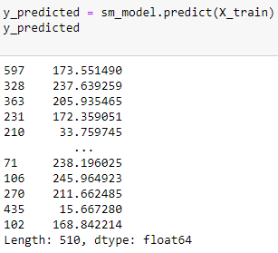
Taking ols model to predict the Outcome of the model.

Slide 23
With our linear model with COUPON and it's interaction with DISTANCE, the value of average Fare for a route where Southwest Airline serves the route (SW = Yes/1) is $357. The value of Fare is decreasing in this case because Southwest Airlines is a low cost airlines and when it starts a new route, the fare will decrease.
With our linear model with COUPON and it's interaction with DISTANCE, the value of average Fare for a route
where Southwest Airline serves the route (SW = No/0) is $395.6. The value of Fare is increasing in this case because if there are n low cost airlines for a route, then FARE for that route will be higher because of less competition.

Slide 24
Conclusion
Based on the above prediction, we can come to a conclusion that whenever a low cost airlines like south-west airlines will start its operation in a new route, the ticket FARE for that route will most likely decrease.

Slide 25
THANK YOU

